Slide 1

Python Functions: Callable Objects, Closures, Decorators
System Development and Design

Slide 2
Lecture Objectives
Create callable objects
Define functions using closures
Modify function behavior using decorators

Slide 3

Functions in Python
Functions are reusable blocks of code.
Python functions are first-class objects:
Can be assigned to variables.
Passed as arguments.
Returned from other functions.

Slide 4
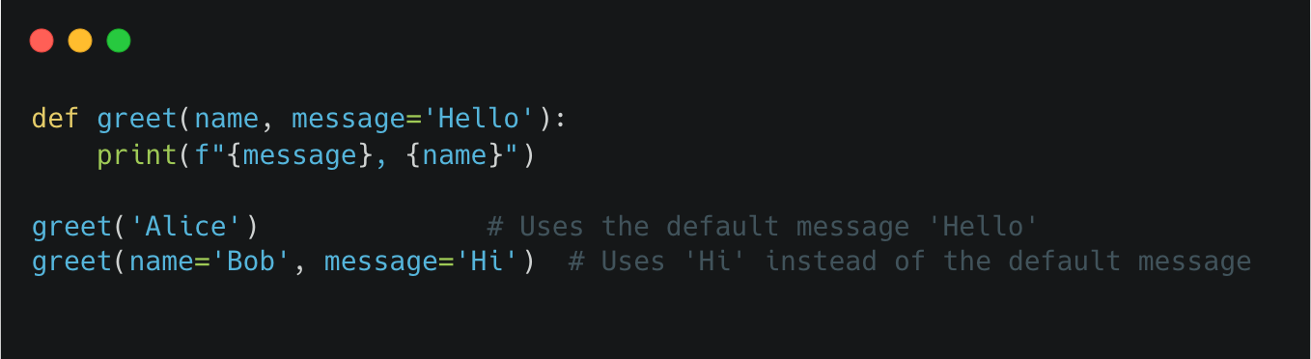
Function Syntax
Python uses indentation instead of braces for scoping.
Argument binding:
By position: Arguments assigned in order.
By keyword: Explicitly mapped to parameter names.
Example:

Slide 5
Higher-Order Functions
Functions that:
Accept other functions as arguments.
Return other functions as results.
Examples:
map()
filter()
reduce()

Slide 6
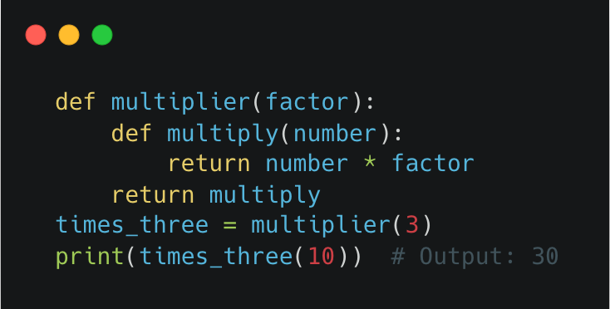
Closures
Functions that 'remember' variables from their enclosing scope.
Used to maintain state between function calls
Example:

Slide 7
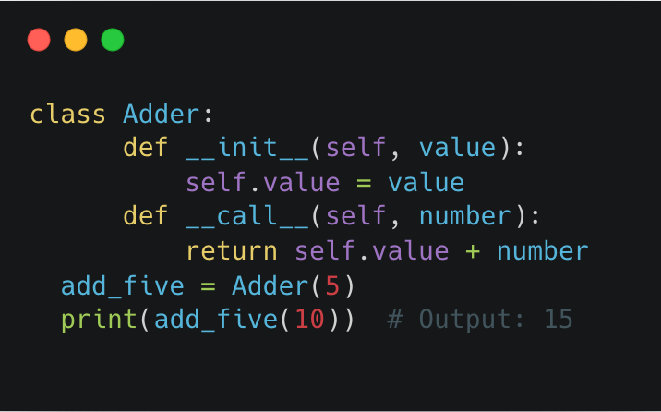
Callable Objects
Objects that behave like functions via the __call__ method.

Slide 8
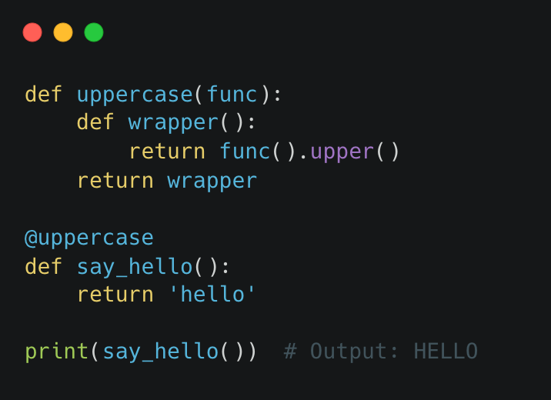
Decorators
Functions that modify the behavior of other functions.
Applied using the @decorator_name syntax.
Example:

Slide 9
Summary
Python functions are versatile and powerful.
Higher-order functions enable functional programming patterns.
Closures and callable objects provide stateful behavior.
Decorators simplify function behavior modification.

Slide 10
Readings and References
Fluent Python (2nd Edition):
Chapter 7: Functions as First-Class Objects
Chapter 9: Decorators and Closures
Learning Python (5th Edition):
Chapter 16: Function Basics
Chapter 17: Scopes
Chapter 18: Arguments
Notes:
Disaster Recovery And Business Continuity

Slide 11
Questions?

